Slide 1
SQL & MySQL
Notes:
https://www.c-sharpcorner.com/UploadFile/65fc13/ddldml-and-dcl-in-mysql/

Slide 2
AGENDA
What is SQL?
Various parts of SQL
Introduction to MySQL
Data types of Mysql
SQL: DDL Commands
Constraints

Slide 3
SQL Fundamentals
1
Structured Query Language

Slide 4
What is SQL?
Full Form: “Structured Query Language”
SQL is a programming language designed for managing and manipulating data stored in relational databases.
SQL provides a standardized syntax and set of commands for creating, querying, modifying, and managing the data within a database.
Notes:
It is a declarative language, meaning that users specify what data they want to retrieve or manipulate, rather than how to retrieve it.
1) SQL is a language
2) A database is a structured collection of data
3) A DBMS is a software that we use to manage our databases

Slide 5
Various parts of SQL
SQL Commands are classified as,
  Data Definition Language (DDL)
  Data Manipulation Language (DML)
  Data Query Language (DQL)
  Data Control Language (DCL)
  Transaction Control Language (TCL)
  View definition
  Embedded SQL and dynamic SQL
  Integrity
  Authorization

Slide 6
Cont...
Data Definition Language (DDL)
Commands for defining and managing database structures.
Data Manipulation Language (DML)
Commands for working with data.
Data Query Language (DML)
Commands for retrieving data.
Data Control Language (DCL)
Commands for managing access and permissions of data.
Transaction Control Language (TCL)
Commands used to manage transactions within a database.

Slide 7
MYSQL
2
Fundamentals

Slide 8
Introduction to MySQL
MySQL is an open source relational database management system based on SQL.
It was designed and optimized for web applications and can run on any platform.
In general, mysql is not case sensitive.

Slide 9
Data Types of SQL in Mysql
Commonly used data types are,
    Numeric Data Types
    String Data Types
    Date and Time Data Types
    Boolean Data Type
    Binary Data Types
    JSON Data Type
    Spatial Data Types
Notes:
https://blog.devart.com/mysql-data-types.html

Slide 10
1. Numeric Data Types
Integers (int)
tinyint (1b) | smallint (2b) | mediumint (3b) | int (4b) | bigint (8b)
Attributes: ZEROFILL, AUTO_INCREMENT, UNSIGNED
Floating-point (Should not be UNSIGNED)
  float (m,d)
  double (m,d)
Decimal [decimal(m,d)]
    Should not be UNSIGNED
Where,
    m is the total number of digits (precision).
    d is the number of digits after the decimal point (scale).
Notes:
Decimals represent numbers with fractions and store exact numeric values in the column.
Usually used for columns that store monetary value.
In the comparison with the floating-point numbers, decimals are more accurate.
Floating-point represent numbers with fractions but do not store exact numeric values.

Slide 11
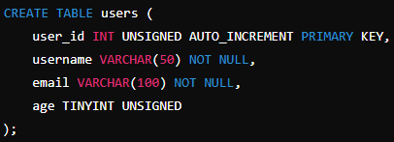
Example

Slide 12
2. String Data Types
VARCHAR(size): Variable-length string with a maximum size specified.
CHAR(size): Fixed-length string with a specified size.
TEXT: For larger text data.
ENUM(value1, value2, ...): Defines a set of enumerated values to choose from.

Slide 13
3. Date and Time Data Types
DATE: Represents a date value (YYYY-MM-DD).
TIME: Represents a time value (HH:MM:SS).
DATETIME: Represents a date and time value (YYYY-MM-DD HH:MM:SS).
TIMESTAMP: Represents a timestamp value (stored as UTC).

Slide 14
3. Boolean Data Type
BOOLEAN or BOOL : Represents true or false values.
True : 1, False : 0 (Case Insensitive)
MySQL does not have a boolean (or bool) data type. Instead, it converts boolean values into integer data types (TINYINT)
Notes:
https://www.javatpoint.com/mysql-boolean

Slide 15
4. Binary Data Types
BLOB: Binary large object for storing large binary data.
VARBINARY(size): Variable-length binary data with a maximum size specified.

Slide 16
5. JSON Data Type
JSON: Stores JSON (JavaScript Object Notation) data.

Slide 17
6. Spatial Data Types
GEOMETRY: Represents geometric spatial objects.
POINT: Represents a point in a coordinate system.
LINESTRING: Represents a sequence of points forming a line.
POLYGON: Represents a polygonal shape.

Slide 18
Data-definition language (DDL)
2
create, modify, and delete database objects such as tables, indexes, views, and schemas.

Slide 19
Commands for Database
CREATE DATABASE <database_name>;
  Ex:
  CREATE DATABASE testDB;
View all Existing Databases
  SHOW DATABASES;
Accessing Database
USE <databasename>;
Deleting Database
DROP DATABASE <databasename>;
Notes:
mysql -u root -p

Slide 20
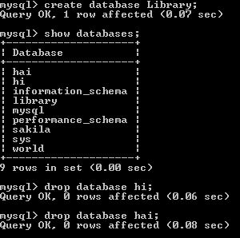
Cont…

Slide 21

Cont…
Clear mysql CMD Prompt:
    mysql> system cls
    mysql> \! cls
    To check current DB
    SELECT DATABASE() FROM DUAL;
Notes:
In MySQL, for instance, you would use SELECT DATABASE(); directly to get the current database name without needing a DUAL table.
DUAL is a special one-row, one-column table in Oracle databases that is used for selecting pseudo-columns like SYSDATE or testing expressions.

Slide 22
Cont…
    How to rename database?
    https://chartio.com/resources/tutorials/how-to-rename-a-database-in-mysql/
Notes:
https://chartio.com/resources/tutorials/how-to-rename-a-database-in-mysql/

Slide 23
Commands for Table
Create Table
  CREATE TABLE table_name (
  column1 datatype,
  column2 datatype,
  column3 datatype,
  ....
  );
To display schema:
DESCRIBE <Table_name>;

Slide 24
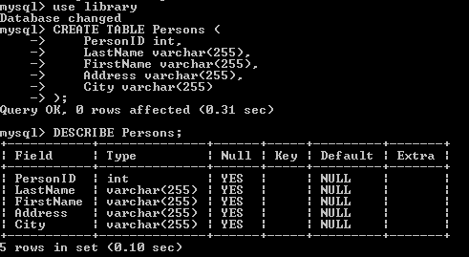
Cont…
Example 1:
CREATE TABLE Persons (
PersonID int,
LastName varchar(255),
FirstName varchar(255),
Address varchar(255),
City varchar(255)
);

Slide 25
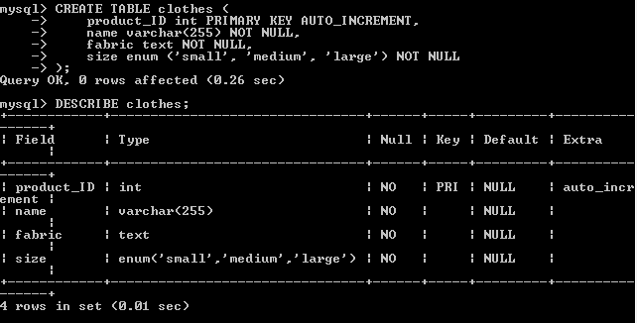
Example 2:
CREATE TABLE clothes (
product_ID int PRIMARY KEY AUTO_INCREMENT,
name varchar(255) NOT NULL,
fabric text NOT NULL,
size enum ('small', 'medium', 'large') NOT NULL
);

Slide 26
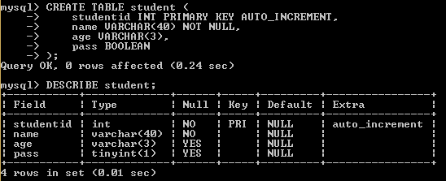
Example 3:
CREATE TABLE student (
studentid INT PRIMARY KEY AUTO_INCREMENT,
name VARCHAR(40) NOT NULL,
age VARCHAR(3),
pass BOOLEAN );
Notes:
https://www.javatpoint.com/mysql-boolean

Slide 27
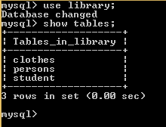
2. Display tables in database
show tables;

Slide 28
☺ Drop & Truncate
3. Delete Table (Drop)
  The DROP TABLE statement is used to drop an existing table in a database.
  Ex: DROP TABLE table_name;
4. Clear Table (Truncate)
  The TRUNCATE TABLE statement is used to delete the data inside a table, but not the table itself.
  Ex: TRUNCATE TABLE table_name;

Slide 29
5. Modify Table Properties (Alter)
The ALTER TABLE statement is used to add, delete, or modify columns in an existing table.
The ALTER TABLE statement is also used to add and drop various constraints on an existing table.
Example 1: (Add new Column)
ALTER TABLE Customers
ADD COLUMN Email varchar(255);
Example 2: (Delete an existing column)
ALTER TABLE Customers
DROP COLUMN Email;
Example 3: (Modify the column’s datatype)
ALTER TABLE Persons
MODIFY COLUMN email char(20);

Slide 30
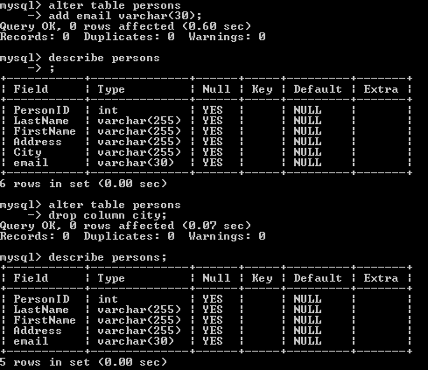

Slide 31
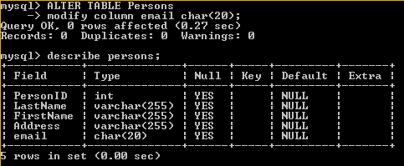
Cont…

Slide 32
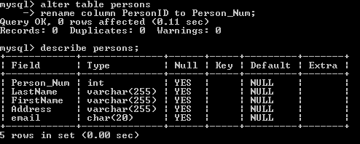
Alter : Rename column name
Example 4: (Modify the column’s name)
ALTER TABLE Persons
RENAME COLUMN person_ID to person_num;
Notes:
https://www.javatpoint.com/mysql-rename-column

Slide 33
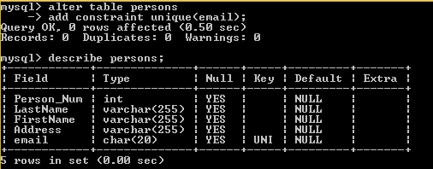
Alter : “Column Constraints”
Example 1:
ALTER TABLE table_name
ADD CONSTRAINT <constraint_name> (column1, column2, ... column_n);
Notes:
https://www.techonthenet.com/mysql/unique.php

Slide 34
Cont…
ALTER TABLE table_name
ADD CONSTRAINT <user_def_constraint_name> <constraint_name> (column1, column2, ... column_n);
ALTER TABLE table_name
DROP CONSTRAINT <usedef_constraint_name>
Note: We cannot modify the constraint. We shall drop a constraint and add a new one. However, if we want to drop, we need to use “user_def_constraint_name” while creating the constraint.

Slide 35
SQL Constraints
3

Slide 36
About SQL Constraints
SQL constraints are used to specify rules for the data in a table.
Constraints can be column level or table level.
  Column Level Constraints: These constraints are applied only to the single column that limits the type of particular column data.
  Table Level Constraints: These constraints are applied to the entire table that limits the type of data for the whole table.

Slide 37
Types of constraint in MySQL
NOT NULL
PRIMARY KEY
FOREIGN KEY
UNIQUE
CHECK
DEFAULT

Slide 38
Cont…
NOT NULL
  Ensures that a column cannot have a NULL value
PRIMARY KEY
  A combination of a NOT NULL and UNIQUE. Uniquely identifies each row in a table
FOREIGN KEY
  It is like a primary key constraint only. But it uniquely identifies a row in another table.
CHECK
  Ensures that the values in a column satisfies a specific condition

Slide 39
Cont…
UNIQUE
  It ensures that a column does not accept duplicate values.
  Both the UNIQUE and PRIMARY KEY constraints provide a guarantee for uniqueness for a column or set of columns.
  A PRIMARY KEY constraint automatically has a UNIQUE constraint.
  However, you can have many UNIQUE constraints per table, but only one PRIMARY KEY constraint per table.
DEFAULT
  Sets a default value for a column if no value is specified

Slide 40
Example 1:
create table Student(
Rollnum int primary key not null,
name varchar(20) not null,
age int default 1,
regnum int unique check(age>18)
);

Slide 41
Examples 2:
create table Student(
Rollnum int not null,
name varchar(20) not null,
age int default 1,
regnum int unique,
check(age>18),
primary key(Rollnum)
);
Notes:
https://www.educba.com/mysql-constraints/

